Slide 1
Digital Analytics for E-Commerce Startup
Name: Ekta Grewal
Date: 06-09-2026

Slide 2
BUSINESS CONTEXT:
CONTEXT
The client is a newly launched e-commerce retail startup that sells stuffed animal toys. The client has provided the online e-commerce data for the period from 19-Mar-2012 to 19-Mar-2015. The company is planning for its next round of funding and needs clear, data-driven insights.
EXPECTED OUTCOME
Measure website and sales performance using meaningful KPIs. To evaluate overall company performance by analysing orders, sales, revenue, website traffic, refunds, and product performance. To conduct predictive analysis to identify future business growth opportunities. Build dashboards for easy stakeholder monitoring.

Slide 3
BUSINESS CONTEXT:
PROBLEM STATEMENT
The e-commerce client is facing challenges in understanding and improving various aspects of their business: Identifying revenue trends Monitoring website and session performance Identifying opportunities for future growth Tracking business growth and key performance indicators Forecasting future business growth & performance Optimising effective strategies for sustainable future growth

Slide 4

KEY STAKEHOLDERS:
CINDY SHARP
MORGAN ROCKWELL
TOM PARMESAN
CEO
Website Manager
Marketing Director
Strategic Decisions & Business Growth
Website Optimisation & Performance
Marketing Strategy & Campaign Management

Slide 5
TABLE OVERVIEW:
Table Name | Key Information | Primary Key | Foreign Key | Column Details
Orders | Order level data | order_id | website_session_id, primary_product_id | Order level Information - user id, items purchased, revenue & cost.
Orders Item | Ordered product level data | Order_item_id | order_id, product_id | Ordered product information – ordered item id, price, cost
Products | Product level data | product_id | N/A | Product information – name, creation date, product id
Website Sessions | Web session information | website_session_id | N/A | User id, UTM/source, device type details
Website pageviews | Web browsing information | website_ pageview_id | website_session_id | Web browsing details - pages visited during visit, creation date
Order item refund | Refund level data | order_item_ refund_id | order_item_id, order_id | Return product info - date, refunded amount

Slide 6
DATA DICTONARY:
ORDERS
Column | Description
Order_id(PK) | Unique id for each order
Created_at | Order creation date & time
website_session_id (FK) | Web session of the order
user_id | Customer identity
primary_product_id (FK) | Main product id
items_purchased | How many items purchased
price_usd | Revenue
cogs_usd | Cost of product
ORDERS ITEMS
Column | Description
Order_item_id(PK) | Unique id for each item
Created_at | item creation date & time
order_id (FK) | Order identity(parent)
product_id (FK) | Product identity/purchased
is_primary_item | Is main product or not
price_usd | Item SP(selling price)
cogs_usd | Cost of item
PRODUCTS
Column | Description
product_id (PK) | Unique id for each product
Created_at | Product creation date & time
product_name | Each product name

Slide 7
DATA DICTONARY:
WEBSITE SESSIONS
Column | Description
website_session_id (PK) | Unique id for each web session
Created_at | Date & time when session created
user_id | User id associated to session
is_repeat_session | New vs old session
utm_source | Marketing source
utm_campaign | Marketing campaign
utm_content | Marketing advertisement
device_type | Device used
http_referer | URL of the website
WEBSITE PAGE VIEWS
Column | Description
website_pageview_id (PK) | Unique page view id
Created_at | View creation date & time
website_session_id (FK) | Web session id
pageview_url | url of visited page
ORDER ITEM REFUND
Column | Description
order_item_refund_id (PK) | Unique id for each refund
Created_at | Refund creation date & time
order_item_id (FK) | Order item id
order_id (FK) | Order id
refund_amount_usd | Refunded amount

Slide 8
ER DIAGRAM:

Slide 9




TECHNOLOGY STACK:
SQL Server :
Power BI:
Data storage, data quality checks and SQL analysis
Interactive dashboard and KPI reporting
Python:
GitHub:
EDA & Predictive Modelling
Project code storage and version control

Slide 10
Data Preparation & Analysis Approach
Reviewed table structure, relationships and data quality in SQL Server.
Performed exploratory analysis to understand sessions, orders, products, customers and marketing.
Created conversion and order-value analysis datasets in Python.
Built visual analysis and KPI dashboards in Power BI.
Applied Logistic Regression and Linear Regression for predictive analysis.

Slide 11
Exploratory Data Analysis - 1
Revenue & Order Info:
Website Performance:
Total Revenue: 💲1.94M
Gross Profit: 💲1.22M
Gross Profit Margin: 62.74%
Total Orders: 32K
Total Units Sold: 40K
AOV: 59.9
Total Sessions: 473K
Total Pageviews: 1.19M
Session Conversion Rate: 6.8%
New Sessions: 26K
Repeat Session: 6K
Total Users: 394K

Slide 12
Exploratory Data Analysis - 2
Return Analysis:
Customer Behaviour:
Total Returned Items: 2K
Return Rate: 4.32%
Highest Returned Product: The Original Mr Fuzzy
Total Refunded Amount: 112.4K
New Sessions: 394K
Repeat Sessions: 79K
Conversion(%) :
New: 7.83
Repeat: 6.64
Orders:
New: 26K
Repeat: 6K
Users:
New: 394K
Repeat: 51K

Slide 13
Power BI Dashboard:
Interactive Dashboards for Data-Driven Decision Making
Objective: To develop interactive Power BI dashboards that monitor key business performance evaluate branch & Operational performance helping stakeholders identify trends and make data-driven decisions.
Executive Overview
Branch & Operations
Menu & Profitability
Monitor overall business performance, profitability, growth.
Evaluate Branch & Operational Performance
Measure Menu Performance & Profitability.
Revenue & Orders
AOV & Gross Margin
Prime Cost
Net Profit
Monthly Trends
Branch Revenue
Orders & AOV
Food Cost
Labour Cost
Prime Cost
Weekend vs Weekday
Category Sales
Quantity Sold
Gross Margin
Top Menu Items
Margin %

Slide 14
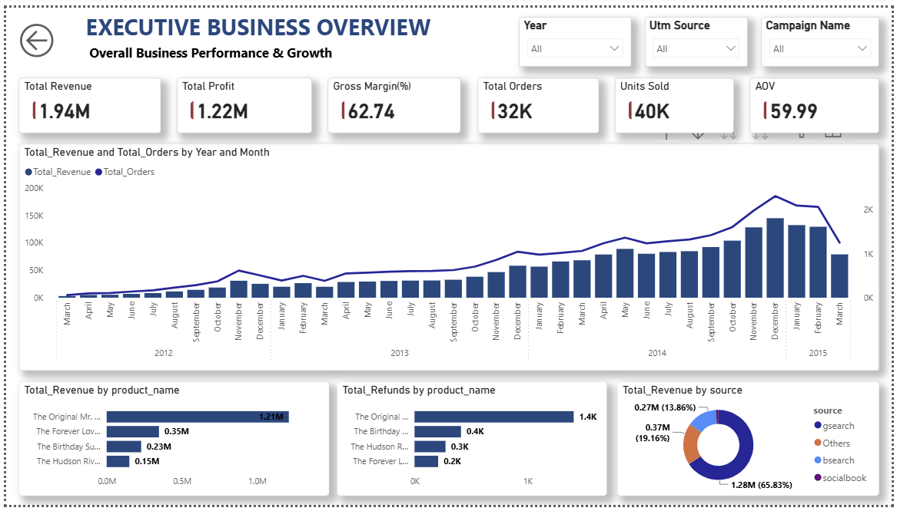

Slide 15
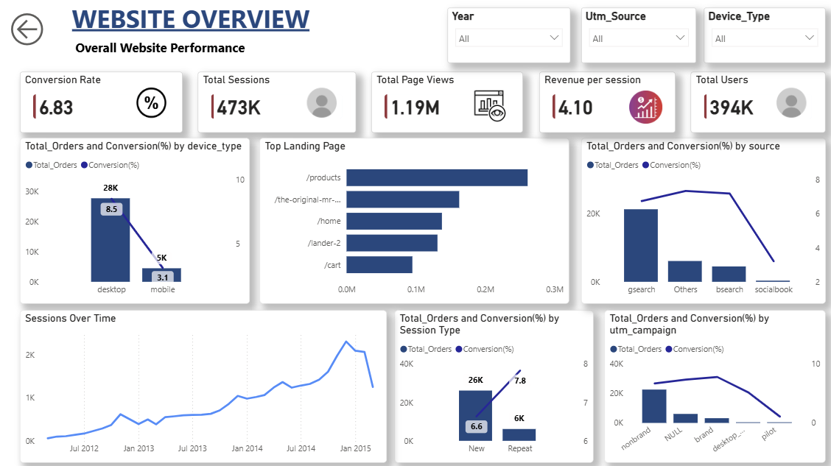

Slide 16
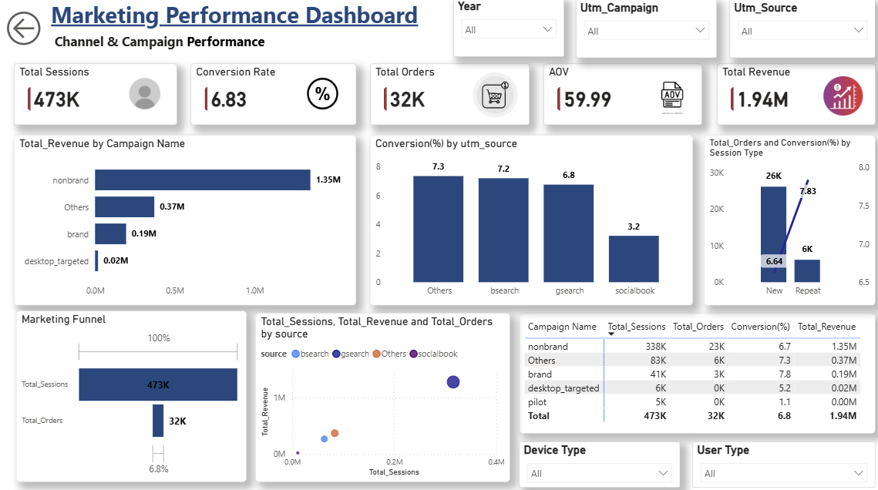

Slide 17
Python Analysis:
EDA, Predictive Analysis & Business Insights
Objective: To analyze website traffic, conversion and marketing performance, and apply predictive models to support data-driven business decisions.
Website & Session Analysis
Marketing Analysis
Understand website traffic and user behaviour.
Evaluating Marketing source and campaign effectiveness
Total Sessions
Conversion Rate
Device wise Conversion
New vs Repeat Sessions
Utm source
Utm campaign
Sessions
Orders and Conversion Rate
Customer Conversion Prediction
Order Value Prediction
Predict whether a web session is likely to get convert.
Predict Order Value Using product, session & marketing attributes
Logistic Regression
F1 Score
Accuracy Score
ROC-AUC
Linear Regression
R2 Score
MAE
MSE
RMSE
KEY FINDINGS:
6.8% overall conversion | Dekstop:8.5%vs Mobile:3.1% | Logistic Regression ROC-AUC: 61% | Linear Regression R2:91%

Slide 18
Key Business Insights:
Website Conversion: The overall website conversion rate was 6.83%, meaning only a small proportion of website sessions resulted in an order.
Mobile Conversion Gap: Desktop conversion was 8.50%, while mobile conversion was only 3.10%, showing a clear difference in purchasing behaviour across devices.
Product Portfolio: The business currently has 4 products, providing a relatively small product range for customers.
Conversion Prediction: The Logistic Regression model achieved 85.46% recall, 8.74% precision and 61.08% ROC-AUC, showing stronger identification of potential converters than precise classification.
Order Value Prediction: The Linear Regression model achieved 91.05% R², with $2.59 MAE and $5.30 RMSE, indicating a strong relationship between predicted and actual order values.

Slide 19
Recommendations:
Improve Mobile Experience: Optimize mobile navigation and checkout to increase the 3.09% conversion rate.
Expand Product Portfolio: Introduce new products and variants to increase customer choice and create additional revenue opportunities.
Boost Repeat Purchases: Use personalized offers and recommendations for repeat visitors.
Focus on High-Performing Marketing: Reallocate marketing efforts toward sources and campaigns generating stronger conversion and revenue.
Influencer Partnerships: Collaborate with relevant creators to expand brand reach, attract new customers, and drive sales growth.
Increase Average Order Value: Introduce bundles and multi-product offers to encourage customers to purchase more items per order.

Slide 20
Thank You
-Ekta Grewal

